Slide 1
Layout Pcell-to-EM Language Translator Update
Yu-Jiu Wang
2013
(This is a quick internal documentation. Don’t follow this slides’ quality and format!)

Slide 2
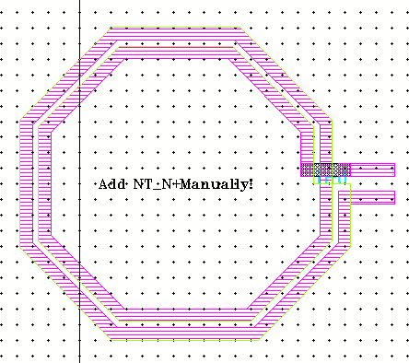
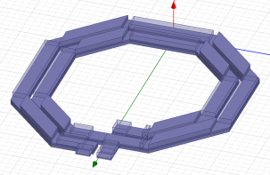

The Systematic RF Design Flow Overview
Initial Theoretic Ideas
$$S_{21}=\frac{s}{s+1}$$
Ideal Symbolic Circuit
Symbolic Circuit with Parasitics
Physical Layouts
Pcell Libraries
EM Simulations
Some are ready.
SPICE Equivalent Models
The blue part is already implemented in RFVLSI lab.
We cover green part in this slides.

Slide 3
Current Two EM Sim Approaches
Write a program based on HFSS Vbscript, and SonnetLab matlab scripting to automate EM simulation.
Pro: design sweep, to find proper component dimensions.
Cons: we need to “manually” check whether the HFSS/Sonnet codes are consistent with the layout.
Use cadence gds-export, HFSS/Sonnet gds-import functions to build EM simulations.
Pro: always consistent with final layout.
Cons: It is inflexible. Lots of human interference. We can only passively verify whether our current layout functions? But not to do a few dimension sweep to choose best layout design.

Slide 4
Skill-to-EM translation?
RFVLSI lab has accumulated many layout pcell codes over the past two tapeouts.
During the two tapeouts, we find we bottlenecked at the layout-to-EM simulation step.
Idea, can we do this?
If possible, then we take advantages of our many layout codes, and seamly integrate them into many different EM simulation tools? (HFSS and Sonnet).
Skill-to-EM
Language
Translator
Sonnet
Simulation
HFSS Codes
PCell SKILL codes
Sonnet Codes
HFSS Simulation

Slide 5
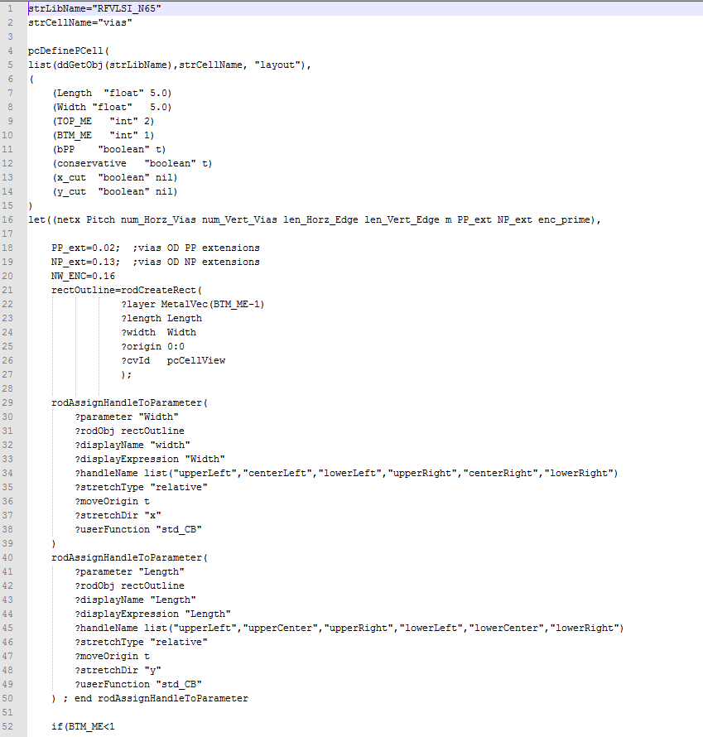
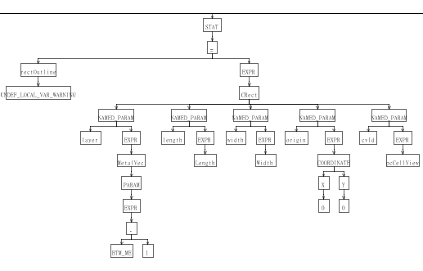
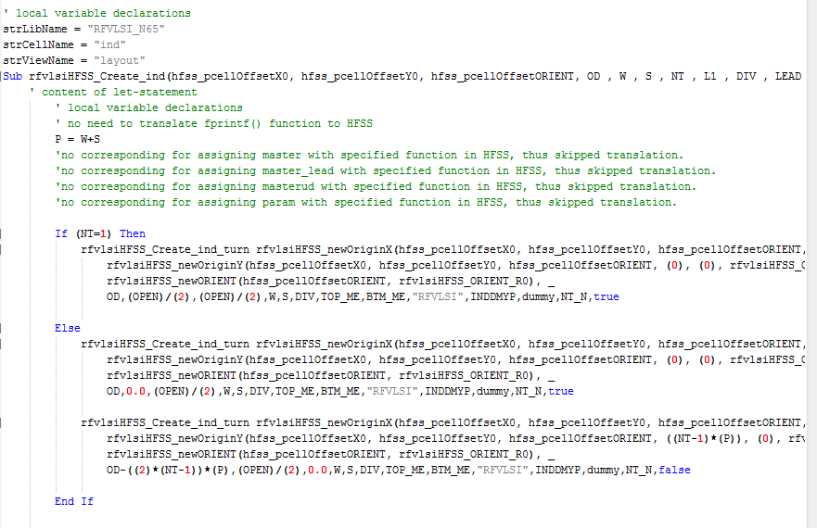
How a language translator works?
Note, SKILL, Vbscript and matlab has different language property. For example, the conditional operator is not supported in Vbscript: A?B:C, so the is no simple way to translate them.
However, if we limit our SKILL to an sufficient language subset, then we can do the translation with too much trivial overheads.
The translation process:
An Abstract Tree that represent the meaning of a SKILL code
SKILL-codes
HFSS or Sonnet Code

Slide 6
Current Architecture
Input file1 & 2:
MetalStack.csv
DielectricStack.csv
Process/EM String Template
Generator
skill_to_hfss
GUI
Input file3:
Some process depedent
Codes from N65.il (Will faded out in the future.)
Process.stg
(Internal only, and invisible to GUI users)
Input file4:
Process generic HFSS *.stg
Input file5:
HFSS.stg
(HFSS process independent template)
A Sim.vbs for a set of parameters ready for simulation
Input file6:
load(“pcell1.il”)
load(“pcell2.il”)
load(“pcell3.il”)
SKILL code files:
Pcell1.il
Pcell2.il
Pcell3.il

Slide 7
New EM Functions in Pcell
masterv=dbOpenCellViewByType(pcCellView~>lib "vias" "layout")
rfvlsiEMDummyCreateParamInst(pcCellView masterv nil 0:0 "R0" 1 list(
list("Length" "float" W)
list("Width" "float" L)
list("TOP_ME" "int" TOP_ME)
list("BTM_ME" "int" BTM_ME))) ; close dbCreateParamInst
;defining Radiation Boundary
rfvlsiEMBoundary(-OD,-2*OD,-300,4*OD, 4*OD,600);
rfvlsiEMVport("port1",-W,-W,W,-W,1,7);
rfvlsiEMDie(-OD,-2*OD,4*OD, 4*OD);

Slide 8
1.rfvlsiEMDummyCreateParamInst
Always place EM dummy before adding port!!!
Usage is the same as dbCreateParamInst for HFSS at PCELL & TOPCELL.
The purpose is to create EM Dummy Ground.
However, rfvlsiEMDummyCreateParamInst will be ignored in PCELL during normal operation.
We can show Dummy Instance by switching to em_debugging mode.

Slide 9
2.rfvlsiEMVport
rfvlsiEMVport("port1",X0,Y0,X1,Y1,BottomMetal,TopMetal);
rfvlsiEMVport("port1",-W,-W,W,-W,1,7);
Create a vertical lump located from (X0, Y0)-(X1, Y1), and connected between:
The bottom of BottomMetal
The top of TopMetal.
rfvlsiEMHport a horizontal version will be implanted as rfvlsiEMVPort.

Slide 10
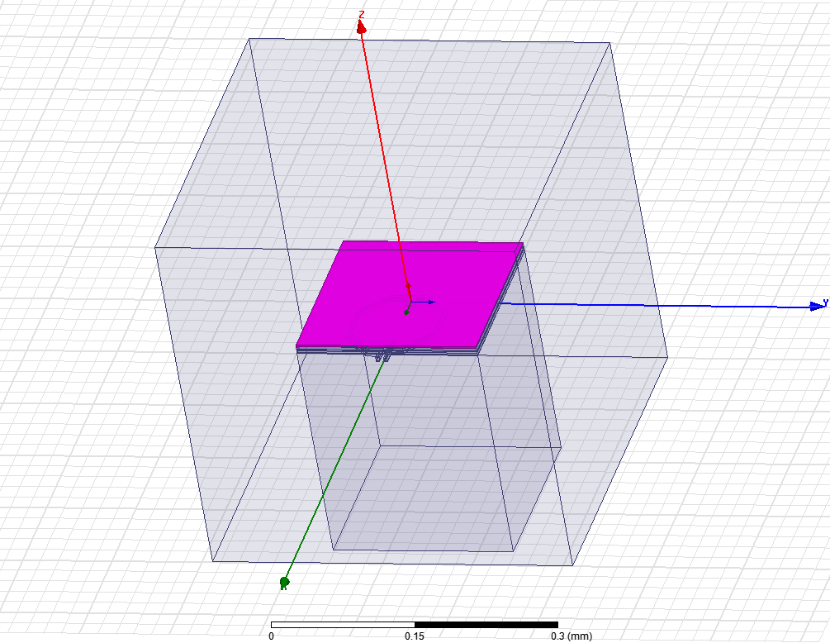
rfvlsiEMBoundary
Create a standard radiation boundary for TOPCELL in HFSS.
rfvlsiEMBoundary(X0,Y0,Z0,Xsize,Ysize,Zsize);
Note, radiation boundary CANNOT touch metals/ports..

Slide 11
rfvlsiEMDie
Create the “substract” & dielectric structure for TOPCELL in HFSS.
rfvlsiEMDie(-OD,-2*OD,4*OD, 4*OD);
rfvlsiEMDie(X0, Y0, Xsize, Ysize);
The program takes care of metal/dielectric overlapping problem.

Slide 12
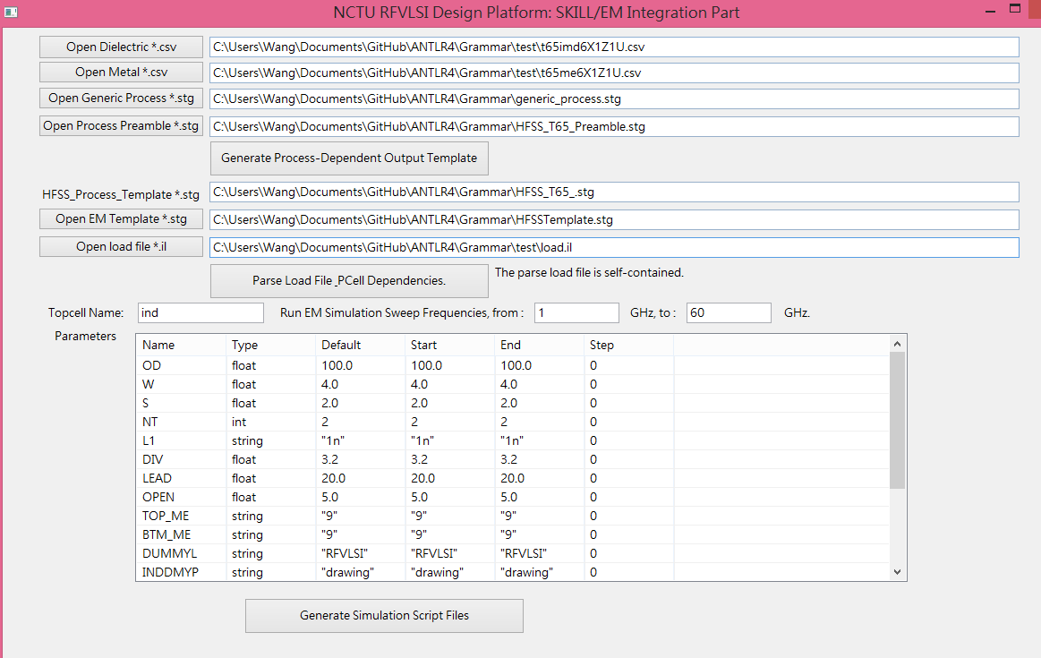
The GUI (at this point)

Slide 13
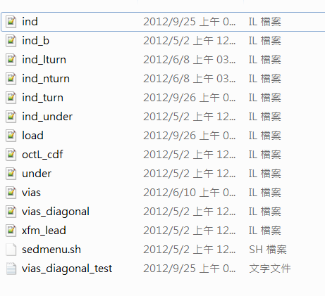
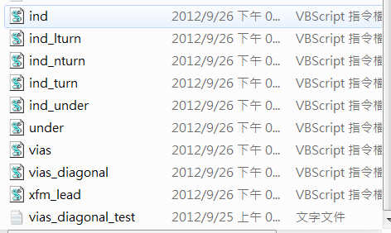
Demo
We use original Pcell, put the necessary *.il codes into a same folder.
Write a load(“pcell.il”) files.
We only modify very few codes from original SKILL source codes. (Not all SKILL language features are supported by VBscript, and I don’t want to waste too much time on less important stuffs, which can be modified easily with errors.)
skill_to_hfss file1 file2
Cadence Layout
Sweeptable HFSS Models
Layout Codes

Slide 14
Operating Java GUI for Translator
Download latest Jave runtime environment (JRE)
For debugging, open a Java console
Use the console in integrated design env. (e.g. Netbeans, Eclipse)
Use Windows “cmd” and type (PATH variable may need to be set before use)
X:\> java –jar skill_to_hfss.jar

Slide 15
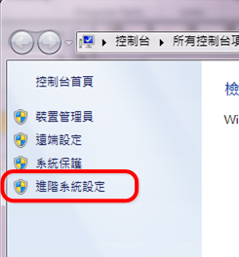
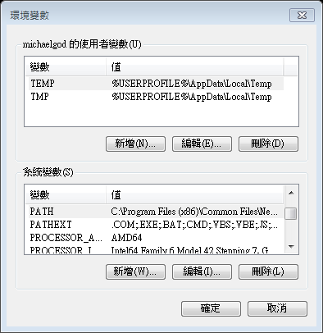
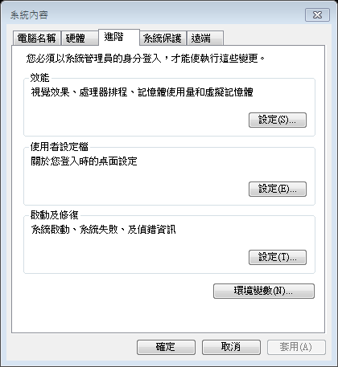
Setting an Environment Variable
Right click on My Computer, click “properties”

Slide 16
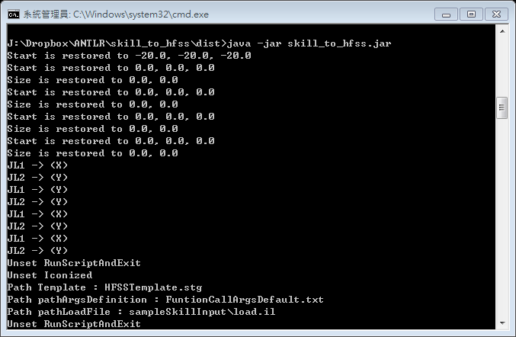
Console View
Use the information in it for debugging (e.g. when program crashes)

Slide 17
RFVLSI-Pcell Writing Principles

Slide 18
Why following this RFVLSI PCell principles
Cadence SKILL language is very comprehensive and flexible. However, SKILL is originated from LISP, but adapted for C/C++ user. So, its language syntax is very “dirty”.
To reduce mistakes at system-level, we will like our group members to limit their creativity to a subset (but sufficient) of coding styles. This bring at least several advantages:
Reduce new member’s learning curve. (So you only limited to learn the “proved subset” of SKILL Language).
Reduce the chance of making system-level mistakes, and more inter-operatability of each other’s mixed-signal designs.
Allow easier implementation of RFVLSI group SKILL debug tracers.
Allow easier implementation of RFVLSI group SKILL-> EM code-level translator.
Allow easier technology porting, e.g. from N65 to N22.
Please communicate if you find this “subset” is really insufficient for you.

Slide 19
Metal Layers
Metal Layers:
MetalVec
Via Layers:
ViaVec
All layers must be function calls.
All other layers usage will be ignored during the SKILL->HFSS compilers.
list(“metal1”, “drawing”) -> constant layer, ignored during translation.
Use RFVLSI Lab technology independent functions: (N65.il)
Please read N65.il, and use functions inside N65.il
Use: roundtogrid, rfvlsi_maskgrid

Slide 20
Lab Global Variables
rfvlsi_em_export = 0 ; added by ywang on 2012/04/12
rfvlsi_tsmc_device_flattened=0; added by ywang on 2014/03/17
rfvlsi_maskgrid=0.005
rfvlsi_em_comment=100;

Slide 21
Supported Function Call Syntax
Only C-style is supported:
FunName(expr1, expr2, expr3, ..)
Example:
pcRound(BA,0.001,3)
FunName(expr1 expr2 expr3 ..)
Example:
dbOpenCellViewByType(pcCellView~>lib "under" "layout")
FunName(value1 value2.. ?argA exprA ?argB exprB )
Example:
cdfCreateParam(g_cdfDataId ?name "wr" ?type "string" ?defValue "2.5u"?prompt "R Width" ?display "t" ?editable "t" ?storeDefault nil ?parseAsNumber "yes" ?units "lengthMetric" ?parseAsCEL "yes" ?callback "")
NEWLINE is fine.

Slide 22
Conditional Statement
if( logical_expr then ..codes..)
if( logical_expr then ..codes.. else ..codes..)
if( a=expr then ..codes.. else ..codes..)
This is supported now, but not preferred. Considered to be removed in the future even though this is SKILL compatible.
case(id
(expr1 ..codes…)
((expr1 expr2 expr3 …) ..codes…)
)

Slide 23
Operators
Conditional Operator (expr?stat1:stat2) not supported
Bit-wise OR, C operator(|) not supported.
Bit-wise AND, C operator(&) not supported.

Slide 24
Looping
for-loop in SKILL is HFSS translation supported.
when-loop in SKILL is HFSS translation supported.
Unless is NOT translation supported, due to no corresponding function in VBScript.

Slide 25
Support Pcell List&coordinates Syntax
list(expr1 expr2 expr3 expr4 …)
‘(expr1 expr2 expr3 expr4 …)
==
scaler_expr1:scaler_expr2
For example: 1:2, A:B+C, A(m):B(D)*C are all okey.

Slide 26
Let Statement Syntax
let((id1 id2 id3 …), …codes…)
let((id1 id2 id3 …) …codes…)
let(((id1 value1) (id2 value2) (id3 value3 …), …codes…)
let(((id1 value1) (id2 value2) (id3 value3 …) …codes…)
If codes assign a variable(idX) that is not defined inside (id1 id2 id3 …), then a warning will be given.
idX=1 ➔ a security warning will be given.
id1=id2+idX ➔ a global scope variable access warning
If let is inside a pcDefinePCell, then a Pcelll parameters/let id will be checked for conflicts.

Slide 27
pcDefinePCell function
pcDefinePCell(list(ddGetObj(strLibName), strCellName, "layout"),
(
(OD "float" 100.0)
(W "float" 4.0)
…..
)
let((id1 id2 id3 …),
…codes…
)
)
strCellName can be replaced by a String constant, for example:
pcDefinePCell(list(ddGetObj(strLibName), “vias”, "layout"),
Let statement syntax

Slide 28
dbCreateRect/rodCreateRect
For HFSS translation, please use layer function:
dbCreateRect(pcCellView
MetalVec(m)
list((-PP_ext):(-PP_ext) (Width+PP_ext):(Length+PP_ext)))
dbCreateRect(pcCellView
ViaVec(m)
list((-PP_ext):(-PP_ext) (Width+PP_ext):(Length+PP_ext)))
rodCreateRect(
?layer MetalVec(BTM_ME-1)
?length Length
?width Width
?origin 0:0
?cvId pcCellView);
All other layer expressions, for example: list(“m1” “drawing”), list(“NP” “drawing”), DiffLayer(“N”) will be skipped and will not be translated to HFSS.

Slide 29
dbCreatePolygon/rodCreatePolygon
For HFSS translation, please use layer function:
dbCreatePolygon(pcCellView
MetalVec(m)
list(
W:-BB A:-BB-A+W
OD+P-A:-BB-A+W OD+S:-BB))
rodCreatePoly (
?layer MetalVec(BTM_ME-1)
?pts
?cvId pcCellView);
All other layer expressions, for example: list(“m1” “drawing”), list(“NP” “drawing”), DiffLayer(“N”) will be skipped and will not be translated to HFSS.

Slide 30
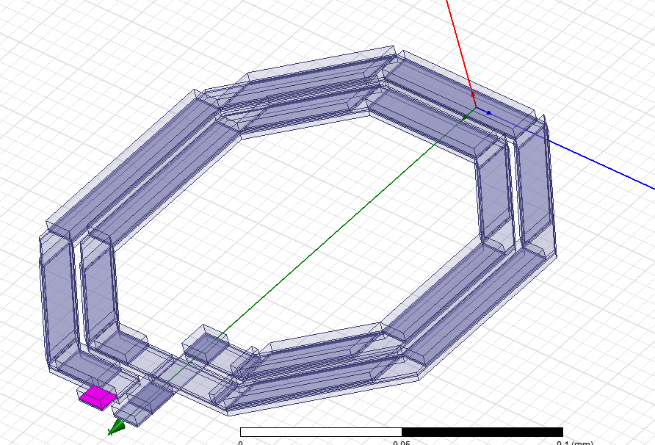
Special Note on dbCreatePolygon
Make sure the Polygon are plotting counter-clockwise (at top level), otherwise, it will grow negative thickness during “grow”-thickness step.
If it is used in as a Pcell, by another pcell, “mirroring” will be recorded to keep track by hfss_ThicknessFactor. (1 for normal, -1 for negative)
M9 polygon grow -3.5um thickness, instead of 3.5um.

Slide 31
dbCreateParamInst
master = dbOpenCellViewByType(pcCellView~>lib "ind_turn" "layout")
dbCreateParamInst(pcCellView master nil X0:Y0 "R0" 1
list(
list("W" "float" W)
list("OD" "float" OD-2*i*(W+S))
list("S" "float" S)
list("DIV" "float" DIV)
)
)
Or
dbCreateParamInst(pcCellView dbOpenCellViewByType(pcCellView~>lib "ind_turn" "layout")
nil X0:Y0 "R0" 1
list(
list("W" "float" W)
list("OD" "float" OD-2*i*(W+S))
list("S" "float" S)
list("DIV" "float" DIV)
)
)
Do not use cons(list1 list2)!!!!!!!!!
Note, both dbOpenCellViewByType & dbCreateParamInst are required.
In this example, the “ind_turn” will be stored in a symbol table for master. Later, when we use dbCreateParamInst, we check master’s value (in the form of tree) and get the correct ID.
If a parameter is not assigned, then default value will be used.
In this example, all red part are very important.
Stored in Symbol Table:
ID | expr syntax tree
master | dbOpenCellViewByType(pcCellView~>lib "ind_turn" "layout")

Slide 32
Function definition
procedure( PinVec(arg1, arg2, arg3,….)
….codes…..
returnVal ; Note, the last line is treated as return value.
) ; end or procedure
procedure( PinVec(arg1, arg2, arg3,….)
….codes…..
returnVal ; Note, the last line is treated as return value.
) ; end or procedure

Slide 33
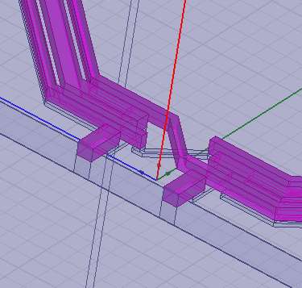
Metals attaching to Port
It is important to make sure that the metals connecting to a port is only reside in one face of the port rectangle, instead of both faces.

Slide 34
(Unsupported) Skip functions
If a cadence function, which is not supported, or with an unsupported syntax. It will be ignored in the translation.
For:
dbCreateRect,
rodCreateRect,
dbCreatePolygon,
rodCreatePolygon,
dbCreateParamInst
Will not be translated, if its coding pattern is not supported. They will, however, be saved in the symbol table, but will not be translated into target language.
Other skip function includes:
cdfDeleteCDF, fprintf, cdfSaveCDF, techGetTechLibName,

